Slide 1

Intro to Web Services
Service-oriented architectures (SOA)
Web services
A simple example in JavaScript

Slide 2
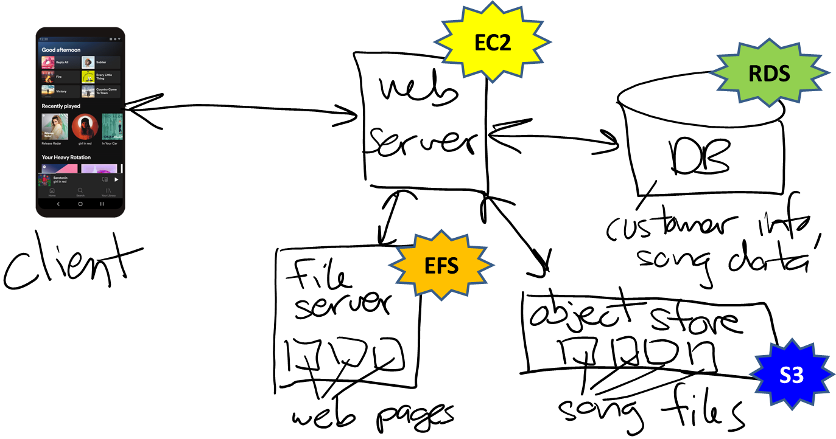
Multi-tier architecture
Recall that most modern software is multi-tier…

Slide 3
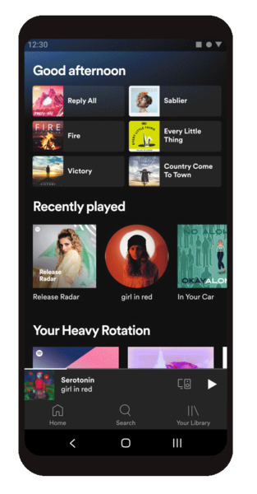
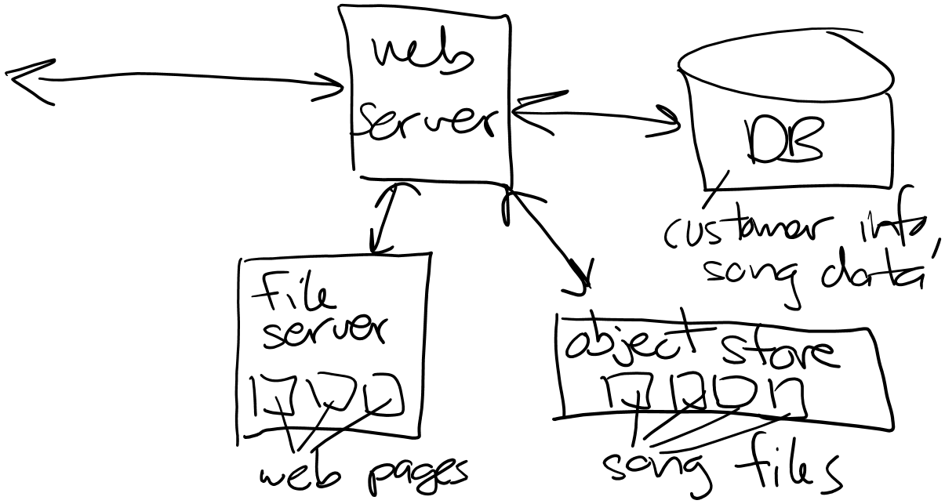
Example
Spotify:
https://developer.spotify.com/documentation/web-api

Slide 4









Service-oriented architectures (SOA)
Redesign server-side as 1 or more services (APIs)
URL ==> unique "address" for calling function

Slide 5









Service-oriented architectures (SOA)
Redesign server-side as 1 or more services
Expose the services using web technologies (HTTP / HTTPS)

Slide 6
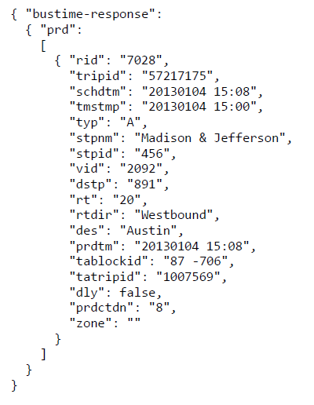
Example #2
Chicago Transit Authority (CTA) monitoring
Web service for real-time bus and L tracking
https://ctabustracker.com/bustime/api/v2/getpredictions?key=KEY&rt=ROUTE_ID&stpid=STOP_ID&format=json
Example: south-bound stop across from of Tech
Notes:
Emphasize that function call is https://.../v2/getpredictions
And the parameters to the function are the query parameters ?key etc.

Slide 7

Request-response protocol
Services adhere to request-response protocol
https://ctabustracker.com/bustime/api/v2/getpredictions?key=KEY&rt=ROUTE_ID&stpid=STOP_ID&format=json
Client
Server
When is the next bus?
Send a request
Send response

Slide 8
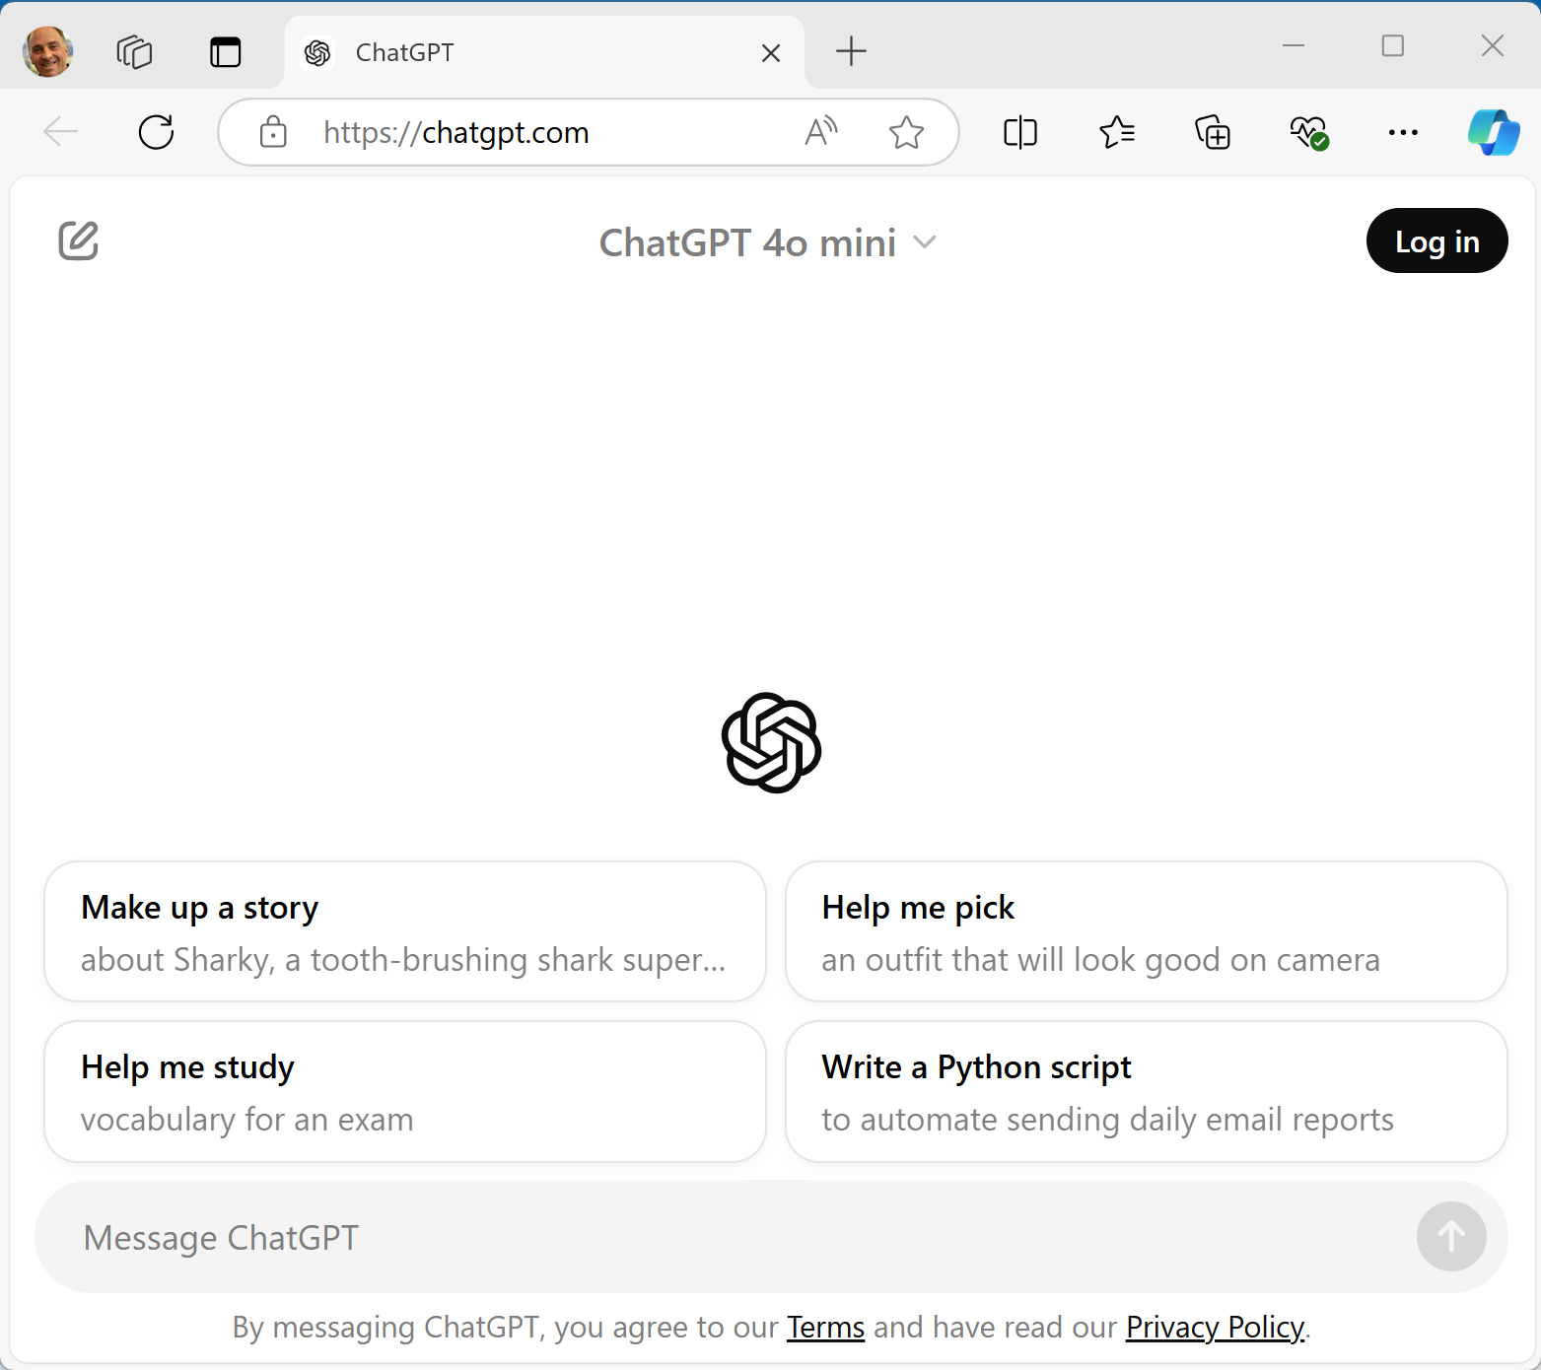
Other API examples…
ChatGPT:
https://platform.openai.com/docs/api-reference/introduction

Slide 9
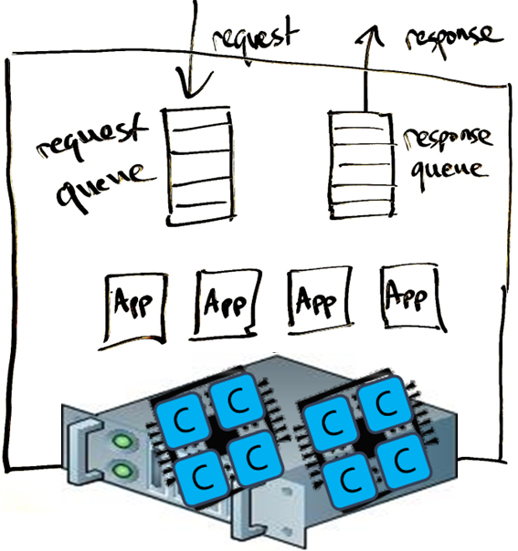
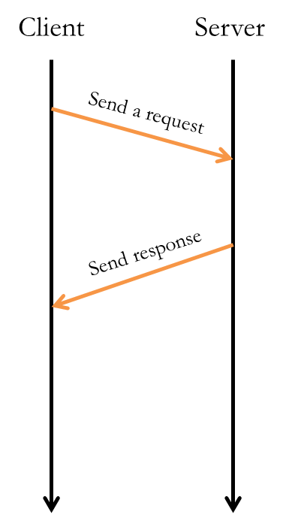
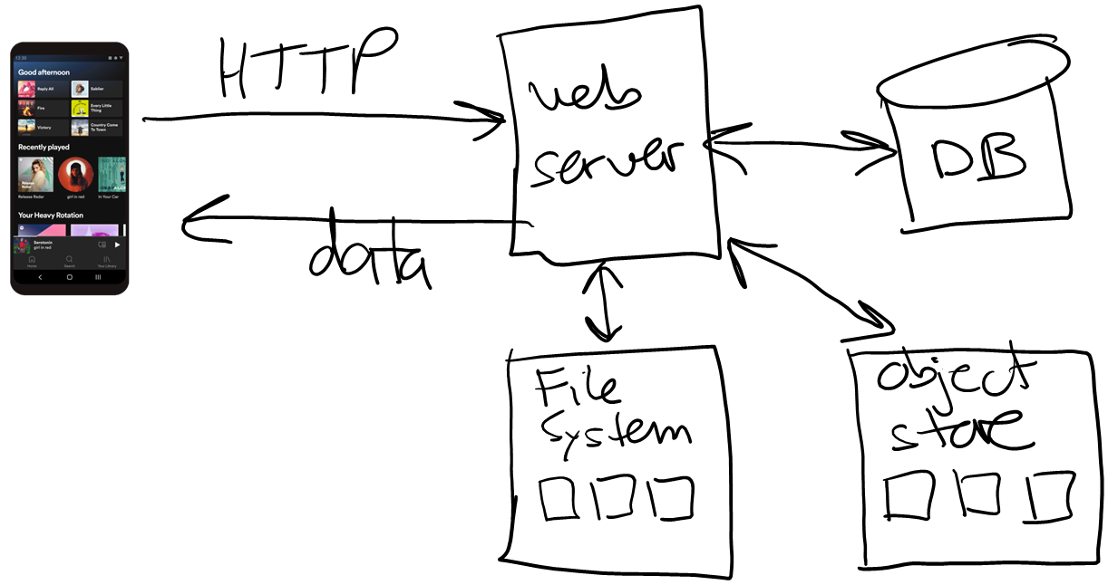
Why use Web Services for building applications?
Web community has already solved the problems designers face:
Support for concurrent users
Client-side configuration
Security / encryption
Supports most programming languages
Lots of frameworks (here are just a few):
Spring (Java)
Django (Python)
Node.js (JavaScript)
Main disadvantages?
Messages as human-readable strings are less efficient
Limited API design options
9

Slide 10
Hyper Text Transport Protocol (HTTP)
HTTP is a client-server data exchange protocol
Invented for web browsers to fetch pages from web servers
Request specifies:
A human-readable header with: URL, method (plus some optional headers)
An optional body storing raw data (bytes)
Response includes:
A human-readable header with response code (plus some optional headers)
An optional body

Slide 11
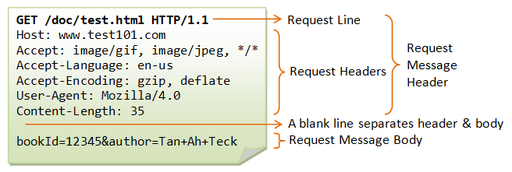
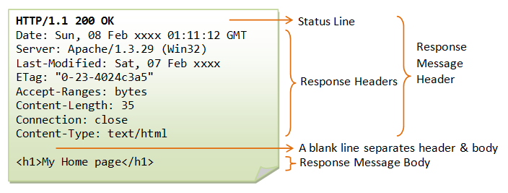
Request:
Response:

Slide 12


Slide 13
Simple SOA example
Let's build a simple calculator web service…
// increment x:
app.get('/incr/:x', (req, res) => {…});
// add x and y:
app.get('/add/:x/:y', (req, res) => {…});
// raise x to the exponent e:
app.get('/pow/:x/:e', (req, res) => {…});

Slide 14
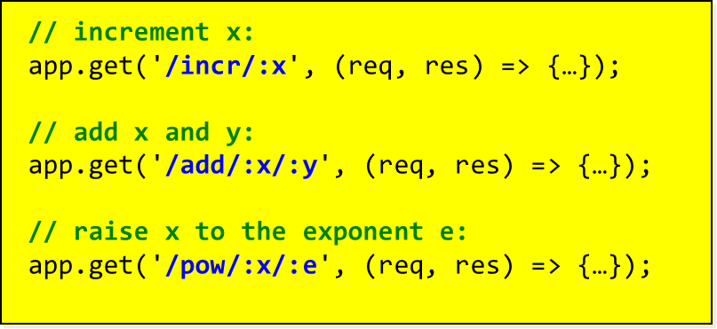


Simple SOA example
Let's build a simple calculator web service…

Slide 15
API function format
This example is using the Express framework
Express is built on top of JavaScript and Node.js
//
// increment the value of x and return it:
//
app.get('/incr/:x', (req, res) => {
}
);
callback function to
execute the call:
req is request object
res is response object
Path (or route)
object representing express application
URL parameter
HTTP method
Notes:
The idea is that function is called when "event" occurs --- in this case when route "/incr" is matched in the URL.

Slide 16
API function format
This example is using the Express framework
Express is built on top of Node.js and JavaScript
//
// increment the value of x and return it:
//
app.get('/incr/:x', (req, res) => {
}
);
callback function to
execute the call:
req is request object
res is response object
Path (or route)
object representing express application
URL parameter
HTTP method
Notes:
The idea is that function is called when "event" occurs --- in this case when route "/incr" is matched in the URL.

Slide 17

Demo : client-side
It's a web service, our client can be a web browser!

Slide 18
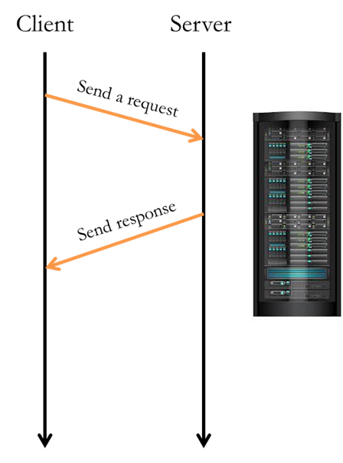
Demo : server-side
Server starts up and listens for requests…
const express = require('express');
const app = express();
// main():
app.listen(3000, () => {
console.log('**SERVER: web service running, listening on port 3000...');
});
// requests for default page /:
app.get('/', (req, res) => {
console.log('**SERVER: call to /');
res.send('<HTML><body>Home page is empty, we are a calculator service!</body></HTML>');
});
// API functions:
// increment x:
app.get('/incr/:x', (req, res) => {…});
// add x and y:
app.get('/add/:x/:y', (req, res) => {…});
// raise x to the exponent e:
app.get('/pow/:x/:e', (req, res) => {…});

Slide 19
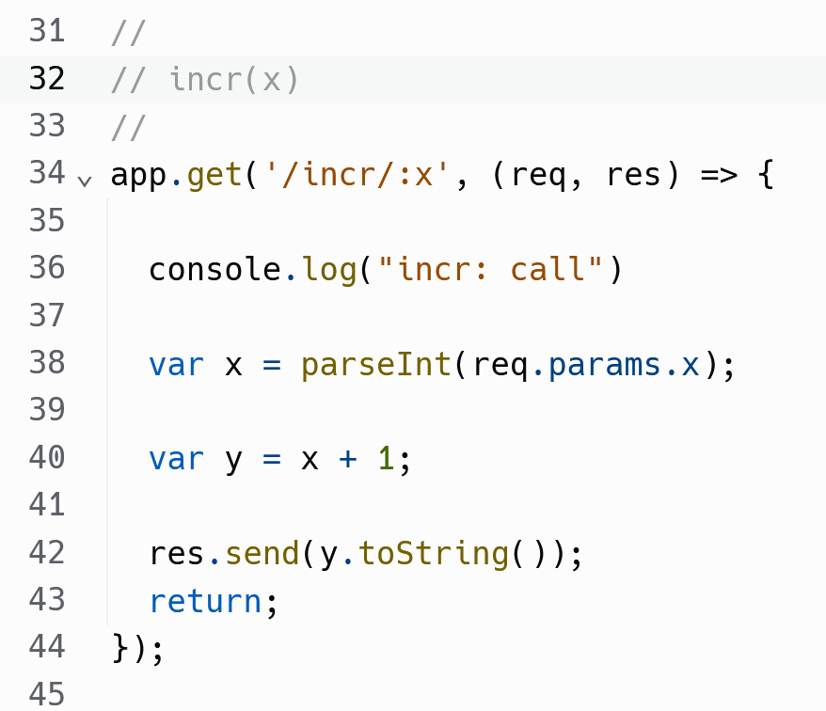
incr(x)
let
let

Slide 20





incr(x)

Slide 21
Exception handling
Exception handling is critical on the server to ensure the client receives a response --- they are waiting!
//
// increment the value of x and return it:
//
app.get('/incr/:x', (req, res) => {
try {
.
.
.
res.send(…); // by default sends code 200 => success
}
catch(err) {
res.status(400).send(err.message); // 400 => bad request
}
});
Notes:
Demo what happens if we pass a string instead of an integer… If that doesn't do it, what if we make a programming error? Server crashes…

Slide 22
Frameworks
Web service running Node.js + Express frameworks
https://nodejs.org/
https://expressjs.com/
Node.js provides JS execution + basic web server support
Express provides additional support for web services

Slide 23
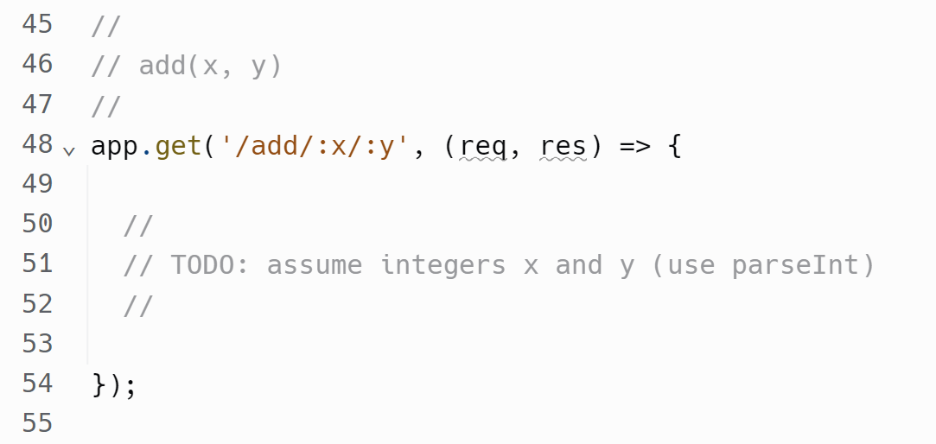
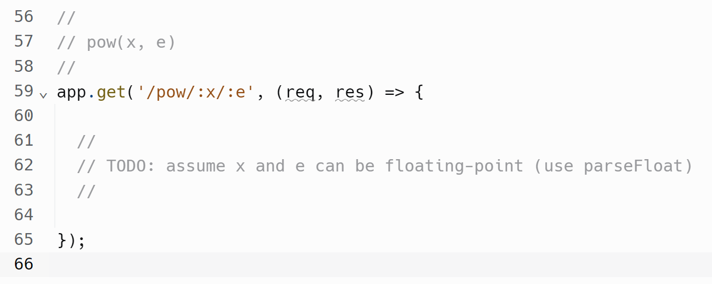
add(x, y) and pow(x, e)
Notes:
app.get('/pow/:x/:e', (req, res) => {
let x = parseFloat(req.params.x);
let e = parseFloat(req.params.e);
let result = x ** e;
res.send(result.toString());
return;
});

Slide 24

Demo : client-side from Python
Use Python's requests networking module
import requests
baseurl = 'http://localhost:3000/'
x = input('Enter integer x> ')
# build URL:
url = baseurl + 'incr/' + x
# call the service:
response = requests.get(url)
# print the result:
print('status code:', response.status_code)
print('result:', response.text)

Slide 25
That's it, thank you!

